Slide 1
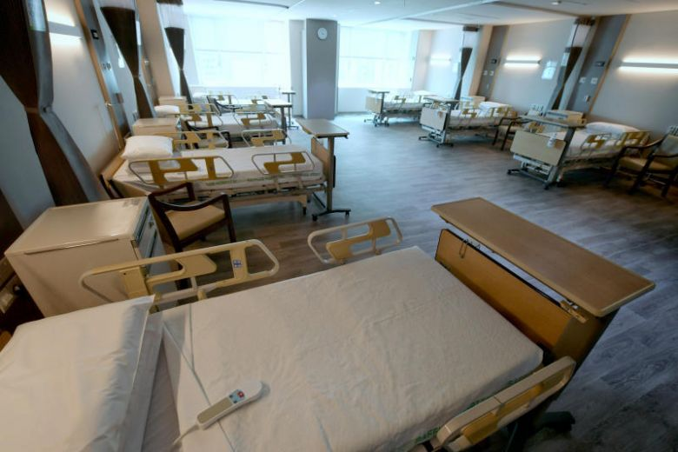
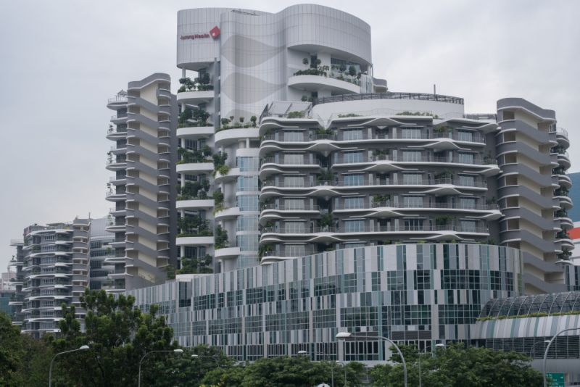
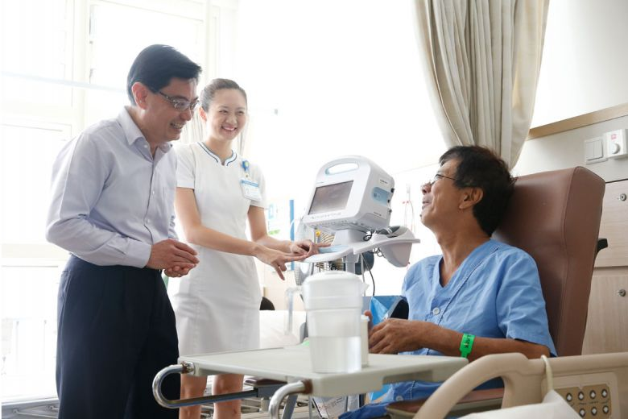
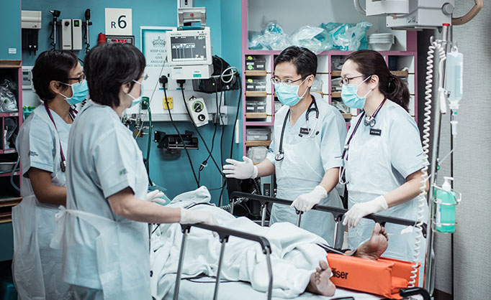
How much does Singapore Government spend on healthcare expenditure?
Heng Li En 191081H

Slide 2
Agenda
01
Government Health Expenditure
Explains the amount Govt spent per year
How much does Singapore Government spend on healthcare expenditure?
02
Subsidies
How one income group relates to Medishield
03
Household Statistics
How income groups get affected by the subsidies given
04
Life Expectancy ( LE )
Death, Diseases and ageing population relates to LE
05
Gain of Investors
Increase of manpower, facilities could reduce the chances of deaths which correlates to LE
Notes:
As you possibly could tell, I’ll be talking about Finance and health. the question I came out with is how much does Singapore government spend on government expenditure, from this question, I would induce and infer the different possibilities, factors of what caused the increased in government health expenditure and the solutions governments have initiated to help in the medical industry.
I would explain first the amount of money the government invest in the health industry and what government spending on. Next, it would be how the 70%(Straits Times,2019) of subsidy given by the government is being segregated in the different income groups. Followed by Household statistics of how much spending is seen in different income groups. Along with the life expectancy where death, diseases and ageing population is a factor With the gain of investors as the last , where increase of manpower, services, facilities could correlate to reducing the deaths affecting Life expectancy.

Slide 3

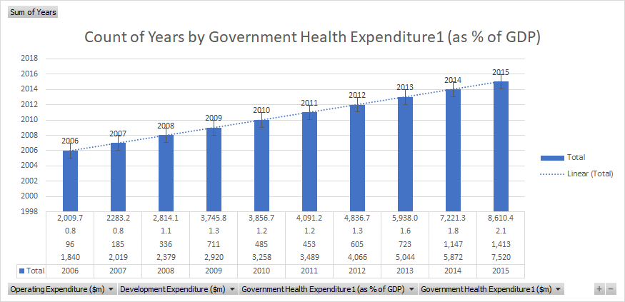
Government health expenditure
Major Factors caused:
Operating Expenditure
-Medical Devices
Development Expenditure
-Medical Services
-Manpower
-Infrastructure
-Investors
- Subsidies
-Ageing Population
Notes:
Insights/inferences explain each of the charts choice of chart type and the information that can be inferred
As the increase of population in Singapore, there would be an increase in the expenses Using this graph to filter the different years and how each factors contributing to government health expenditure. I added a trendline to show the increasing trend over the years and how GDP is affected due to the amount of money the government has spent on the healthcare industry. Furthermore, the government health expenditure is spent accordingly through two different categories, operating and development expenditure. For operating expenditure is the increase in medical devices, the exports and imports and how the market size would grow. For development expenditure, it would be the improvement of medical services, manpower, infrastructure, investors, subsidies and ageing population.

Slide 4
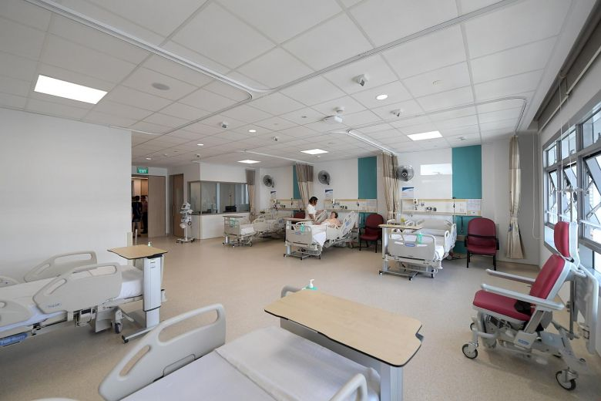
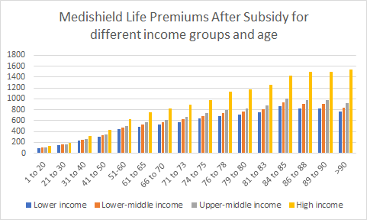




Subsidies (Medisheild)
Graph
Increasing trend
Abnormalities
Comparison
Age= Subsidies Given
% of each income groups
Income groups (benefits)
Reducing financial burden
Increase of subsidies
Notes:
Insights/inferences explain each of the charts choice of chart type and the information that can be inferred
Using bar graphs better explains why different income groups are awarded a different amount of subsidies. Using Medishield as one of the subsidies, people who age 41-50 of the lower-income group ($305) as compared to higher-income group($ 435).This means after subsidy higher income groups wowhich is $130 difference from the lower-income group. As seen in the graph, it is of an increasing trend of how lower-income, lower-middle and upper middle income and heavily subsidized and the amount paid after subsidy is minimal. However, for the higher income, and people aged above 86 would still need to pay more as they are under the higher income groups. Furthermore, the ageing population does not affect the amount of medical fee they have to pay every year except above age 90 in the lower to an upper-middle-income group which is seen decreasing. This explains that different age groups determine the amount they are able to receive. So the hypothesis inferred is the higher you earn, the lower amount of subsidies is given. So from this graph, you are able to tell how government subsidies could benefit each income group and how effective it is on reducing the burden an individual might face.
However, the abnormalities could be seen in the age group of 90 and above. People of upper middle income in aged 90 ($800-1000)(900?)and above received lesser than people in the aged between 89-90,($800-1000)($800-850)

Slide 5
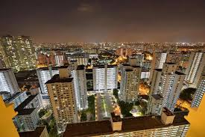
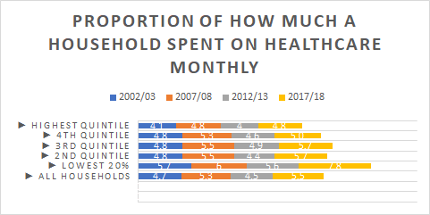
Household Statistics
Household Statistics
drastic increase of 2.2% in the lowest percentile in the past five years.
lower income household is of reliance towards the medical subsidies as compared to other income group.
It also means that lower household income might have a higher chance of getting sick and needing to spend more on medical services
Notes:
So you might wonder how household statistics relate to subsidies. Using stacked columns graph explains the different quintile an income group lands and how much it affects one household spending per month. For example, households with older persons are most likely to receive more transfers on average from schemes such as from pioneer generation package.they are also more likely to receive more healthcare-related subsidies so they generally consume more healthcare services. However, the lower 20% of the household has a higher usage of spending, this could be due to the chances of people getting sick often and how reliant they are towards using government subsidies. This means that the subsidies catered for the lower-income groups would be efficient since accessibility and affordability healthcare is available.

Slide 6
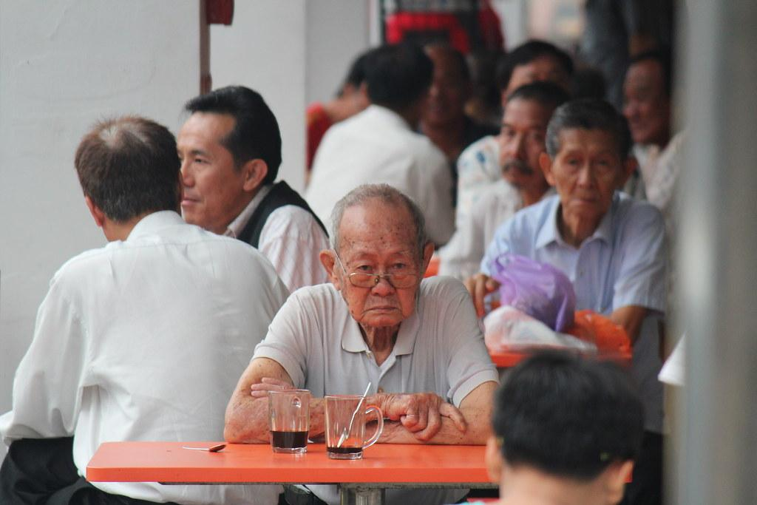
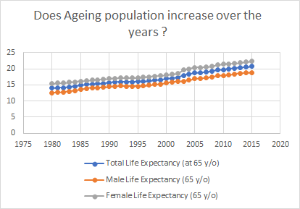
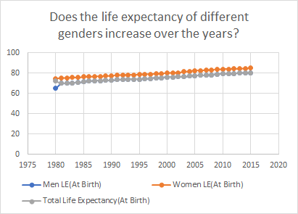
Life Expectancy
Life expectancy
Notes:
Firstly, the ageing population aged 65 and above is seen to be increasing of both genders. However, between 2000 to 2005 there is a huge increase and the main factor could be how government invests more on the operating and developing expenditure. I would like to say that despite disabling health conditions remained, high percentage of the elderly who deal with diseases or major illness still brought an extension of life expectancy showing the rate of diseases affected is low. So looking at the comparison of two graphs, it would explain how the ageing population or just average population are both on the increasing trend and how life expectancy is one of the contributions towards government health expenditure increasing.

Slide 7

Stakeholders
Influencer
Policy Maker
Regulator
Delivery System
Economic Development Board (EBD)
Ministry of Health(MOH)
Ministry of Health(MOH)
Healthcare Clusters
Smart Nation Programme Office (SNPO)
Ministry of Health Holdings
(MOHH)
Health Sciences Authority (HSA)
Individual Hospitals
Infocomm
Development Authority (IDA)
Ministry of Social and Family Development (MSF)
Professional Bodies
Agency for Integrated Care(AIC)
Integrated Health Information System (IHIS)
Notes:
Insights/inferences explain each of the charts choice of chart type and the information that can be inferred
So the stakeholders are the main contributions to improving the healthcare industry in Singapore and how investors who invest in Singapore hospitals could benefit from it. Not just that, Singaporeans(consumers) are able to gain an increased of improved medical services, equipment, facilities through the investors help.

Slide 8
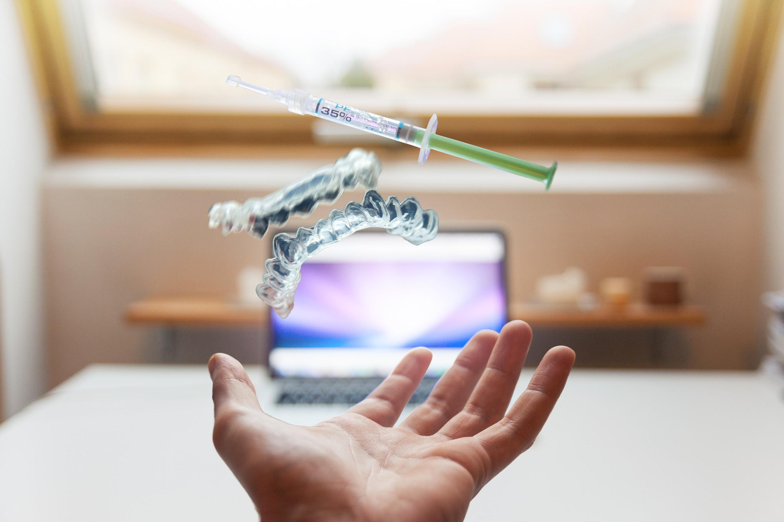
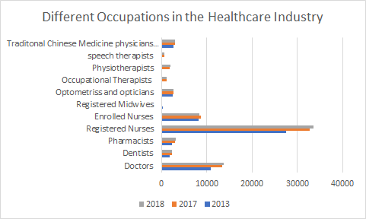
Gain of investors benefits
Gain of investors benefits
Increasing trend,Increased of manpower
As seen the amount of registered nurses has increased as high as an approximately 34000 nurses, excluding enrolled nurses
attracted more foreigners or professionals from overseas to come and work in the singapore healthcare industry.
Notes:
As seen from this graph could clearly see the increased of manpower in the medical industry, For example, using registered nurses as a reference to the number of people accepted over the years, which is approximately 34000 nurses, excluding enrolled nurses. Furthermore, opportunities and increased healthcare medical equipment would attract more Singaporeans working overseas to come back and help in the Singapore healthcare industry.

Slide 9
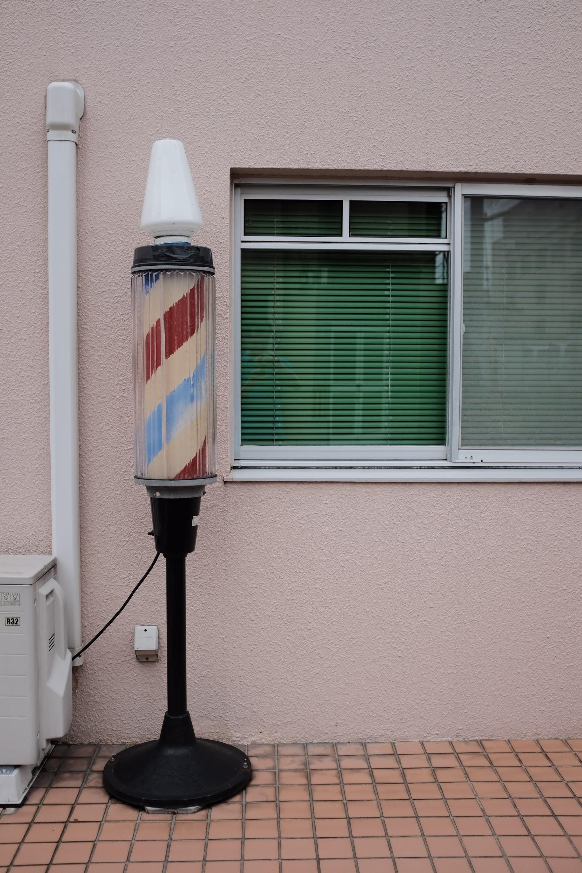
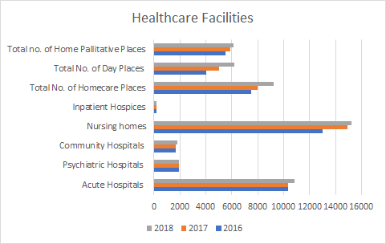
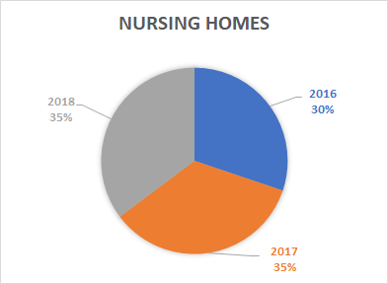
Health Facilities
Health Facilities
Using the chart, separating all the different health-care facilities which include, community hospitals,nursing home,seniors care home and others
Focusing on nursing home, residential long term,as an example which shows that the amount of health facilities increased as the life expectancy of ageing population increases.this is to ensure that all singaporeans are able to have a place to stay.
Notes:
The use of this chart was to explain the increasing amount of facilities was to cater to the ageing population and how health facilities are one of the things the government spent on for the development expenditure.Especially you could see the increase in health facilities among the years due to the increase in life expectancy in the ageing population.

Slide 10

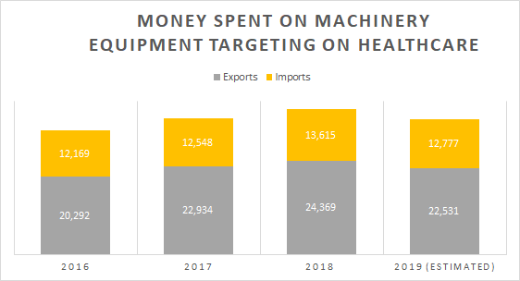
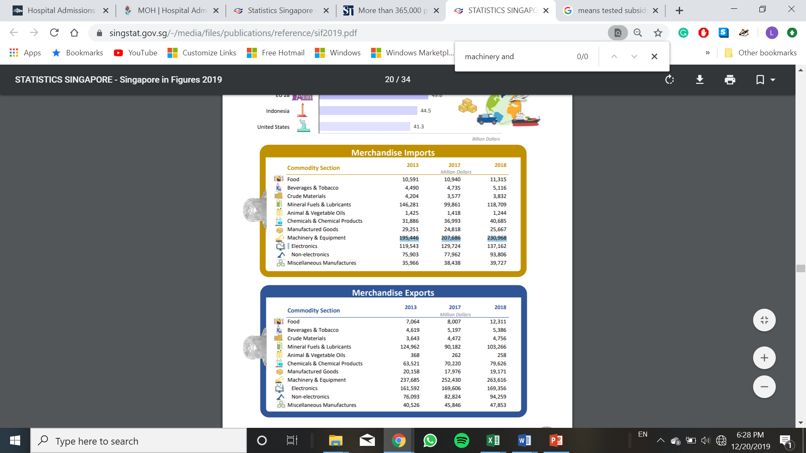

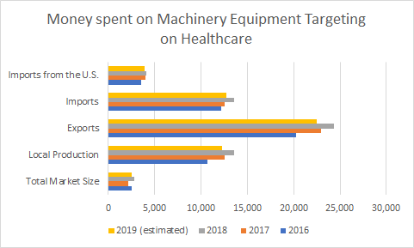
Equipment Expenditure
Equipment Expenditure
Notes:
Insights/inferences explain each of the charts choice of chart type and the information that can be inferred
How life expectancy increased as they upgrade their medical equipments
The amount of money spent on machinery equipment for healthcare is extensive.From the amount of money invested on AI equipment to cure or a spot of less distinguishable diseases is increased which is the number of imports brought into Singapore. Furthermore, the number of exports also increased. The reasons for increased exports could be due to the relation to Singapore healthcare being one of the best and how devices available in Singapore might be useful to other countries.
Because of remarkable advances in science and technology, life expectancy in Singapore increases. This would in result affect the elderly people, which promising growth of medical devices brought into Singapore, creating a sustainable demand for medical devices. As elderly populations’ healthcare is frequently government-subsidized in markets, home healthcare is also becoming of increasing importance which is the SEMAS, which I will further explain later. So as related technologies become more effective, and healthcare budgets are carefully inspected and used in a proper way.

Slide 11

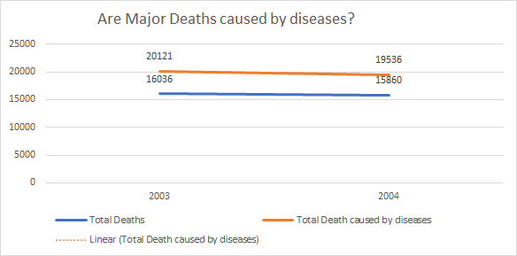
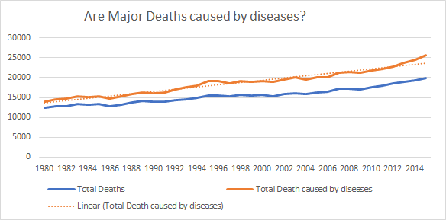

Death Rates
Death Rates
The higher the Diseases Existed, the increase of death is seen in singapore (Hypothesis)
Medical equipment Reducing the death rates
Notes:
Insights/inferences explain each of the charts choice of chart type and the information that can be inferred
So the line graph could inferred a hypothesis of how the higher the diseases found or exist, there is a higher increase of death seen in Singapore. However, despite medical equipment, death rates have also been increasing over the years. This would explain why life expectancy could be affected by the number of death rates caused in a year by diseases. However, abnormalities would be found when there is improvement. With advancing medical technologies equipment has been purchased and used in Singapore, this shows the reduction on the number of diseases or illnesses. For example ,Year 2004 , where it is spotted that the death rate caused by diseases is 19536, which is lower than the previous year 2003, 20121 people died from diseases. However, I would like to highlight that It could be seen that diseases are the main reason why Singaporeans faced which contradicts the high life expectancy, this means that the diseases/illnesses are the major factors of causing death rates to be high.

Slide 12
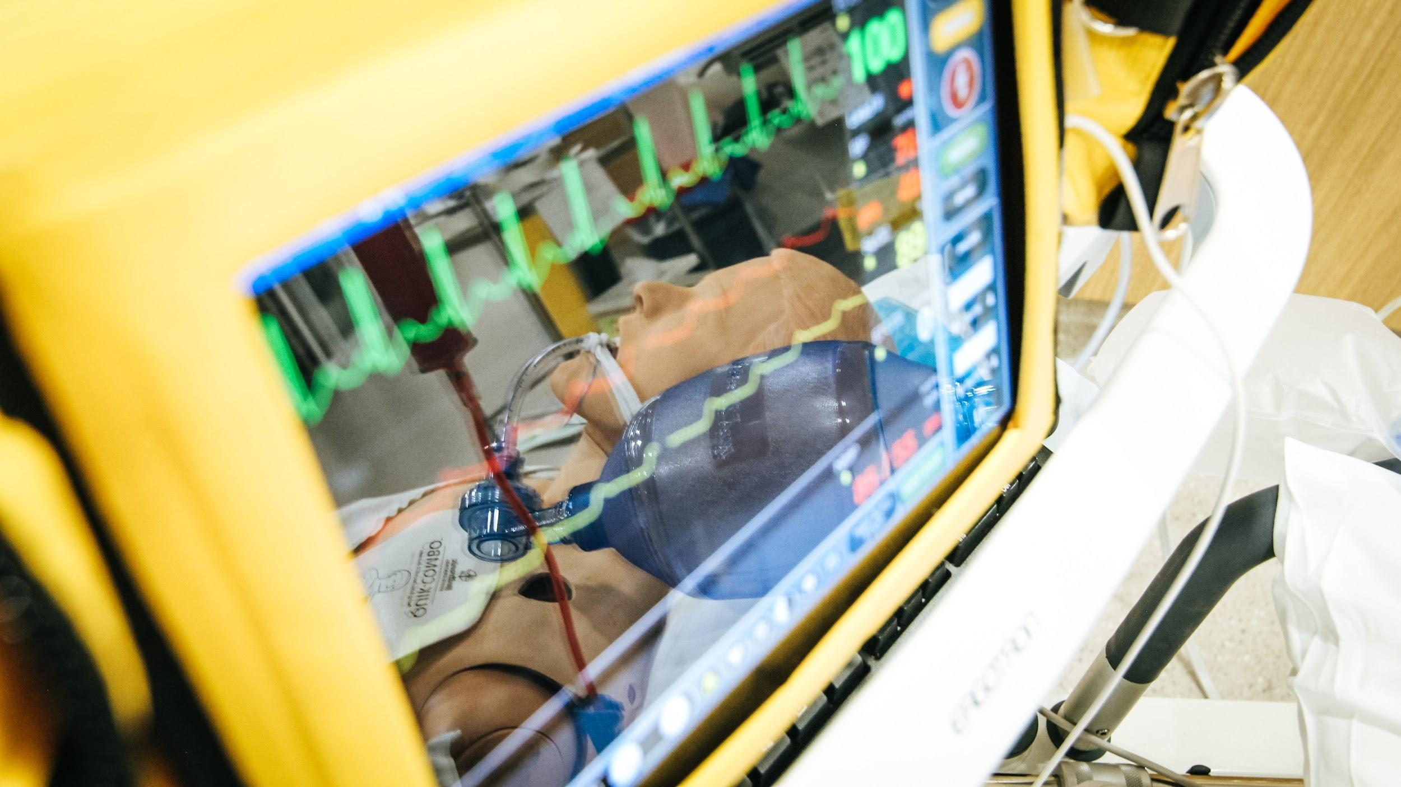
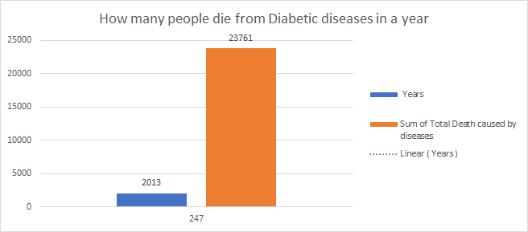
Diabetes as a Factor
how 1 out of the 3 (MOH,2019)would be diabetic and how some diseases are actually interconnected with diabetic patients, causing the death rate to increase.
explains the number of singaporeans getting diabetes is high and how government has been trying to take preventive measures.
Notes:
Insights/inferences explain each of the charts choice of chart type and the information that can be inferred
Using a Bar chart is one of an easier method to explain the different years and how the sum of death caused, one part of the death rates increased is due to diabetes. So using diabetes as one of the common factors that are often a concern towards Singaporean life expectancy, I could relate to how diabetes could be one common disease that may occur in many Singaporeans and how it is estimated ⅕ of the population that might suffer and pass away from diabetes. Furthermore, patients might have other diseases that could also be interconnected to a diabetic patient, causing the death rates to increase. Hence government would have to focus on reducing the number of diabetic patients(specifically type 2, where patients getting diabetes is not by heredity) through the increase of medical services or equipment that could possibly reduce the impact or slow down the diabetes conditions on diabetic patients. Due to the increased rate of diabetic patients, this would explain why the government would take preventive measures which would be mentioned later on the solutions.

Slide 13

Recommendations and solutions

Slide 14
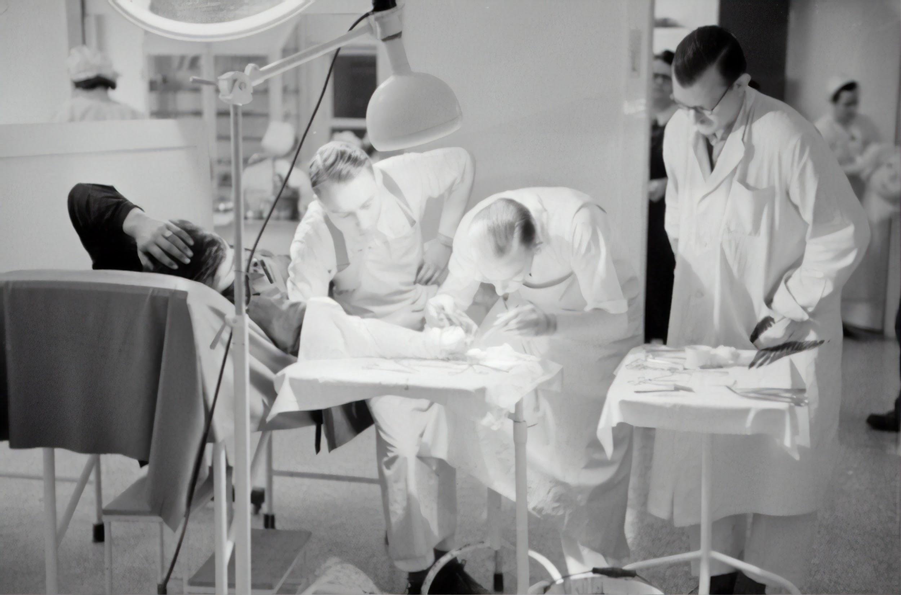
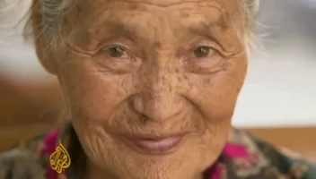
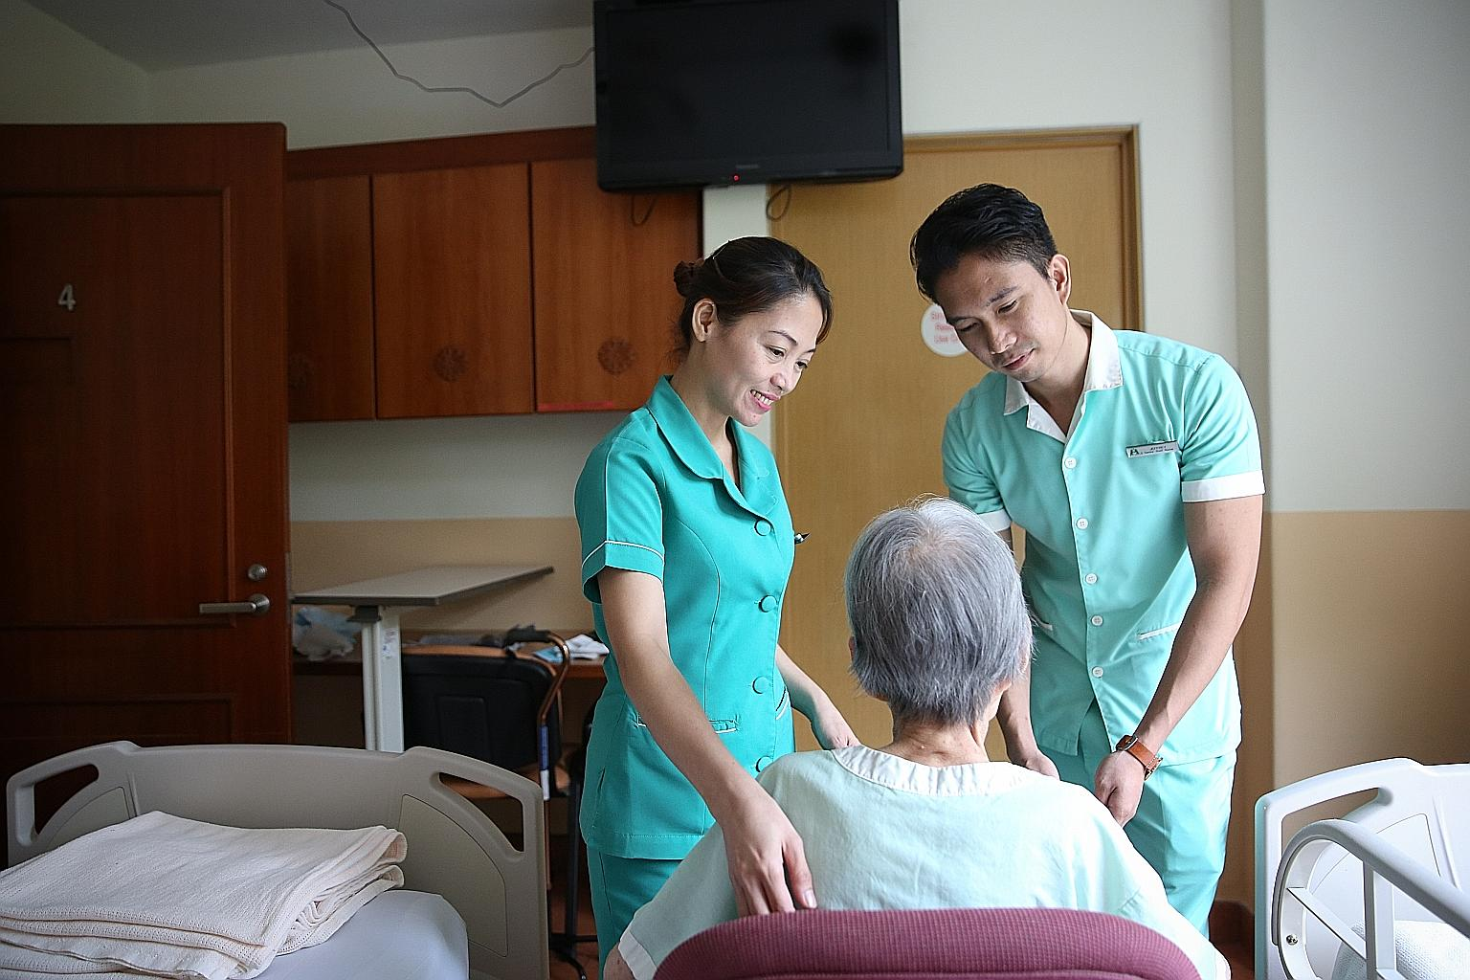

Rising healthcare Cost
Challenges Faced by the Government
Challenges faced by the government
Increased In Ageing Population
Limitation of Healthcare Workers
Notes:
Challenges faced by the government would be the increased in ageing population, limitation of healthcare workers and rising healthcare cost.

Slide 15

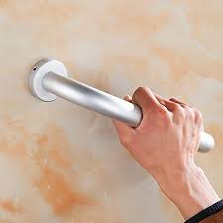




Solutions
Elder friendly Housing
Senior Mobility and Enabling fund(2018-2022)
Subsidies
Expansion of Hospitals
Clinic Care Facilities
Increase of AI and Medical Devices - faster adoption of new diagnostic,therapeutic technologies
Notes:
Elder-friendly housing where grab barriers are available in their houses and how it is convenient for the elderly to grab them. Furthermore, the increase of manpower where caregivers are there to help support seniors.100 million is also top up to the senior mobility and enabling fund for the ageing population. Subsidies like Pioneer generation benefitted 450,000 Singaporeans and increased subsidies on healthcare services and medication. For the expansion of hospitals and facilities are like Health City Novena National Centre for Infectious Diseases(NCID) where it could be used in emergency cases of large outbreaks of diseases. Seniors are also offered with assistive devices and home healthcare items. Technology like SEMAS is catered for the elderly to monitor their routines with assistive devices and ensure their safety for the disabled elderly who stays at home. There is also an increase of AI for clinical diagnosis and physicians would be able to give better feedback to patients and health screenings that are affordable and subsidies are available to encourage Singaporeans for frequent checkups. This explains better utilisation of data analytics and AI.
Could be used in more intensive care units where it can be used to alert hospital staff if there were emergencies or possible incidents happening where they can reduce mortality rate by detecting abnormalities in patients vital signs -AI
Faster adoption of new diagnostic and therapeutic technologies
Conclusion and recommendations that conclude the insights and inferences and make relevant recommendations to improve the situation.

Slide 16
Thank you
End of Presentation

Slide 17

Process
Links :
1: Gathering of Data sources
looking at different sources of websites,images/infographics which links has been stated
2: Data of certain excel sheets has been combined together
for example,the Le where different genders of the ageing population lE
(similar,common denominator)
3: cleaning and trimming of data sheets and removing of duplicates
Notes:
So as stated here , the data transformation of the excel sheets is more of having the sum of total deaths each years to correlate back to the life expectancy And how i managed to gather all the data is through websites, infographics provided on the internet which i have cite it at the last few slides.For similar excel sheets with same content, but different factors, i tried to combine them to make it easier to have it in the same excel sheet and plotting out graph in a much better context.Cleaning and trimming of excel sheets were applied and remove of unnecessary information is done.

Slide 18
References

Slide 19
Links
Opportunities within the healthcare sector in Singapore, Opportunities within the healthcare sector in Singapore 1–41 (2015). Retrieved from https://www.business-sweden.se/contentassets/4e16e1cdc4d242c49d3ae90abe4c5ec3/business-sweden-singapore_report-on-opportunites-within-healthcare.pdf
Govt sets aside record S$19b for science and tech research. (n.d.). Retrieved from https://www.todayonline.com/singapore/govt-invest-s19b-rd-push-over-next-five-years.
(n.d.). Retrieved from https://www.google.com/search?q=government+expenditure+on+health+care&rlz=1C1CHBF_enSG840SG840&sxsrf=ACYBGNSmS-FdkkYyxbmGsU6l4a7WycBDOA:1575722750571&source=lnms&tbm=isch&sa=X&ved=2ahUKEwjBrr_WyKPmAhUYWCsKHadCDmAQ_AUoAnoECA4QBA&biw=1280&bih=578.
Singapore's healthcare expenditure to hit US$24.6b by 2020. (n.d.). Retrieved from https://sbr.com.sg/healthcare/news/singapores-healthcare-expenditure-hit-us246b-2020.
Khalik, S. (2017, December 7). Spending on healthcare expected to rise sharply. Retrieved from https://www.straitstimes.com/politics/spending-on-healthcare-expected-to-rise-sharply.
International Health Care System Profiles. (n.d.). Retrieved from https://international.commonwealthfund.org/stats/?cat=medical_technology.

Slide 20
Links
(n.d.). Retrieved from http://apps.who.int/nha/database/ViewData/Indicators/en.
(2017),Retrieved from:https://www.singaporebudget.gov.sg/data/budget_2017/download/FY2017_Analysis_of_Revenue_and_Expenditure.pdf
(2018),Retrieved from:
https://www.singstat.gov.sg/modules/infographics/-/media/Files/visualising_data/infographics/industry/health-services-2018
Sin, Y. (2018, January 28). Finding a cure for rising costs in healthcare. Retrieved from https://www.straitstimes.com/politics/singapolitics/finding-a-cure-for-rising-costs-in-healthcare.
Government Spending On Education And Healthcare. (n.d.). Retrieved from https://www.singaporebudget.gov.sg/budget_2020/about-budget/budget-features/govt-spending-on-education-and-healthcare.
Budget Process.
(n.d.). Retrieved from https://www.singaporebudget.gov.sg/budget_2020/about-budget/budget-process.
(2019),Retrieved From:https://www.singaporebudget.gov.sg/docs/default-source/budget_2019/download/pdf/35-MOH-2019.pdf
List of countries by total health expenditure per capita. (2019, December 1). Retrieved from https://en.wikipedia.org/wiki/List_of_countries_by_total_health_expenditure_per_capita#World_Health_Organization.
Sim, R., & Straits Times. (2019, February 18). Singapore Budget 2019: Measures announced to tackle healthcare costs, support companies and workers. Retrieved from https://www.businessinsider.sg/singapore-budget-2019-measures-announced-to-tackle-healthcare-costs-support-companies-and-workers/.

Slide 21
Links
Global is Asian,M Ramesh and Azad Singh Bali
https://lkyspp.nus.edu.sg/docs/default-source/gia-documents/the-healthcare-system-in-singapore-with-graphics.pdf?sfvrsn=f0446c0a_2
Government Health Expenditure and Healthcare Financing. (n.d.). Retrieved from https://www.moh.gov.sg/resources-statistics/singapore-health-facts/government-health-expenditure-and-healthcare-financing.
Khalik, S. (2019, March 11). Parliament: Rate of growth in healthcare spending unsustainable, says Gan Kim Yong. Retrieved from https://www.straitstimes.com/singapore/health/rate-of-growth-in-healthcare-spending-unsustainable-gan.
10 Things You Need to Know about Diabetes. (n.d.). Retrieved from https://www.healthhub.sg/live-healthy/1336/10-things-you-need-to-know-about-diabetes.
Hermesauto. (2019, July 25). Growth in Singapore medical device market cut to 8.4% for 2018-2023: Report. Retrieved from https://www.straitstimes.com/business/economy/growth-in-singapore-medical-device-market-cut-to-84-for-2018-2023-report.
Hermes. (2019, December 13). The way forward for informed consent in medicine. Retrieved from https://www.straitstimes.com/opinion/the-way-forward-for-informed-consent-in-medicine.
Chart of the Day: Singapore's medical device market value to hit $1.3b by 2023. (n.d.). Retrieved from https://sbr.com.sg/healthcare/news/chart-day-singapores-medical-device-market-value-hit-13b-2023.

Slide 22
Links
Health. (n.d.). Retrieved from https://www.singstat.gov.sg/find-data/search-by-theme/society/health/latest-data.
Singapore - Medical Devices Singapore - Medical Devices. (n.d.). Retrieved from https://www.export.gov/article?id=Singapore-Medical-Devices.
(n.d.). Retrieved from https://www.edb.gov.sg/en/our-industries/medical-technology.html.
(2019).Pg 118,Retrieved From:https://apps.who.int/iris/bitstream/handle/10665/324835/9789241565707-eng.pdf?ua=1
Health. (n.d.). Retrieved from https://www.singstat.gov.sg/find-data/search-by-theme/society/health/latest-data.
(2019),Retrieved From:https://www.singstat.gov.sg/-/media/files/publications/reference/sif2019.pdf
Health Manpower. (n.d.). Retrieved from https://www.moh.gov.sg/resources-statistics/singapore-health-facts/health-manpower.
Khalik, S. (2016, January 19). Number of foreign doctors rising in Singapore public hospitals and polyclinics. Retrieved from https://www.straitstimes.com/singapore/health/number-of-foreign-doctors-rising-in-singapore-public-hospitals-and-polyclinics.
(2019)Retrieved from: https://www.singstat.gov.sg/-/media/files/publications/households/pp-s25.pdf
(2019)retrieved from:https://www.singstat.gov.sg/-/media/files/publications/reference/sif2019.pdf
The True Cost Of Healthcare In Singapore That Every Singaporean Should Be Aware Of. (2019, June 11). Retrieved from https://blog.seedly.sg/the-true-cost-of-healthcare-in-singapore-that-every-singaporean-should-be-aware-of/.
Households - Latest Data. (n.d.). Retrieved from https://www.singstat.gov.sg/find-data/search-by-theme/households/households/latest-data.

Slide 23
Links
Kurohi, R. (2019, June 19). Singapore ranked No. 3 in survey on use of AI in healthcare. Retrieved from https://www.straitstimes.com/singapore/health/singapore-ranked-no-3-in-survey-on-use-of-ai-in-healthcare
(n.d.)retrieved from:https://www.moh.gov.sg/docs/librariesprovider4/default-document-library/skills-framework-for-healthcare.pdf
healthcare. (n.d.). Retrieved from https://data.gov.sg/dataset?q=healthcare.
Household Healthcare Expenditure. (n.d.). Retrieved from https://data.gov.sg/dataset/household-healthcare-expenditure?view_id=774363ed-8385-4d52-8b71-f6827fa6ac05&resource_id=10882b91-504a-4b5a-8f69-801f7f3436c2.
Healthcare Expenditure in Singapore. (n.d.). Retrieved from https://www.healthhub.sg/a-z/health-statistics/15/household-healthcare-expenditure.
(n.d.). Retrieved from https://www.google.com/search?q=ageing+population+in+singapore&rlz=1C1CHBF_enSG840SG840&sxsrf=ACYBGNTnSChqVwGbC3RPvYvXO9
hkYCloBA:1575722492364&source=lnms&tbm=isch&sa=X&ved=2ahUKEwiG2K_bx6PmAhVBJHIKHaw-ArkQ_AUoAXoECBAQAw&biw=1280&bih=578.
(NLB,2015)Retrieved From:http://www.nlb.gov.sg/sure/wp-content/uploads/2015/08/NLB_CheatSheets7_Ageing-Population.pdf
Elderly, Youth and Gender Profile - Latest Data. (n.d.). Retrieved from https://www.singstat.gov.sg/find-data/search-by-theme/population/elderly-youth-and-gender-profile/latest-data.

Slide 24
Links
Chuan, T. Y. (2018, January 25). Spending on seniors will go up in upcoming Budget: Indranee Rajah. Retrieved from https://www.straitstimes.com/singapore/more-spending-on-services-for-the-elderly-in-budget-2018-indranee-rajah.
Yahya, Y. (2018, January 23). More can be done to meet needs of older Singaporeans: Heng Swee Keat. Retrieved from https://www.straitstimes.com/singapore/heng-more-can-be-done-to-meet-needs-of-older-sporeans.
(n.d.). Retrieved from https://www.google.com/search?q=subsidies+in+singapore&rlz=1C1CHBF_enSG840SG840&sxsrf=ACYBGNQpfChnhTYs-NrmGnlfD-8AuE2vKg:1575722861602&source=lnms&tbm=isch&sa=X&ved=2ahUKEwiDnLiLyaPmAhVSfSsKHVbAD-UQ_AUoAXoECA0QAw&biw=1280&bih=578#imgrc=AVqGrvsajT3w0M:
Healthcare in Singapore. (n.d.). Retrieved from https://www.guidemesingapore.com/business-guides/immigration/get-to-know-singapore/healthcare-in-singapore.
Healthcare Schemes & Subsidies. (n.d.). Retrieved from https://www.moh.gov.sg/cost-financing/healthcare-schemes-subsidies.
CHAS benefits 1.2 million Singaporeans. (n.d.). Retrieved from https://www.todayonline.com/singapore/chas-benefits-12-million-singaporeans.
(MOH).Retrieved from:https://www.moh.gov.sg/docs/librariesprovider5/resources-statistics/educational-resources/3menglish_final.pdf
(who)Retrieved from:https://apps.who.int/iris/bitstream/handle/10665/324835/9789241565707-eng.pdf?ua=1

Slide 25
Links
Disease Burden. (n.d.). Retrieved from https://www.moh.gov.sg/resources-statistics/singapore-health-facts/disease-burden.
(n.d.). Retrieved from https://www.bloomberg.com/news/articles/2018-09-19/u-s-near-bottom-of-health-index-hong-kong-and-singapore-at-top.
Khalik, S. (2019, June 20). Singaporeans have world's longest life expectancy at 84.8 years. Retrieved from https://www.straitstimes.com/singapore/health/singapore-tops-in-life-expectancy-at-848-years.
Hays, J. (n.d.). HEALTH AND HEALTH CARE IN SINGAPORE: TECHNOLOGY, TRANSPLANTS, MEDICAL TOURISM. Retrieved from http://factsanddetails.com/southeast-asia/Singapore/sub5_7c/entry-3774.html.
Singapore 3rd in the world for life expectancy: WHO report. (n.d.). Retrieved from https://www.todayonline.com/singapore/singapore-3rd-world-life-expectancy-who-report.
Death and Life Expectancy - Latest Data. (n.d.). Retrieved from https://www.singstat.gov.sg/find-data/search-by-theme/population/death-and-life-expectancy/latest-data#Death-and-Life-Expectancy_5f413b1e08eb4581b78738dbfbcc7764_footnote.
Wong, D. (2018, October 17). Singaporeans' average life expectancy to reach 85.4 years in 2040, third-highest in the world: Study. Retrieved from https://www.straitstimes.com/singapore/health/singaporeans-life-expectancy-to-reach-854-years-in-2040-third-highest-in-the-world.
(n.d.). Retrieved from https://www.google.com/search?q=hospital&rlz=1C1CHBF_enSG840SG840&sxsrf=ACYBGNQlHph-vo44e19DrhWXYHLBr68HAQ:1575117568035&source=lnms&tbm=isch&sa=X&ved=2ahUKEwjh4vyY-pHmAhXpILcAHU1HAAoQ_AUoAnoECA8QBA&biw=1280&bih=529#imgrc=qTn18HyWBxMmTM.
Notes:
https://www.tablebuilder.singstat.gov.sg/publicfacing/createDataTable.action?refId=15158\
https://www.singstat.gov.sg/find-data/search-by-theme/population/death-and-life-expectancy/latest-data#Death-and-Life-Expectancy_5f413b1e08eb4581b78738dbfbcc7764_footnote
https://www.tablebuilder.singstat.gov.sg/publicfacing/createDataTable.action?refId=13247
https://www.tablebuilder.singstat.gov.sg/publicfacing/createDataTable.action?refId=15167
https://www.tablebuilder.singstat.gov.sg/publicfacing/createDataTable.action?refId=13249
https://www.singstat.gov.sg/find-data/search-by-theme/population/death-and-life-expectancy/latest-data
https://ourworldindata.org/why-do-women-live-longer-than-men
https://www.straitstimes.com/singapore/health/singaporeans-life-expectancy-to-reach-854-years-in-2040-third-highest-in-the-world
Images to be used
Govt spent on healthcare images: https://www.google.com/search?q=government+health&rlz=1C1CHBF_enSG840SG840&sxsrf=ACYBGNSLqk6VaFsVi5RzPp_CjmuKCWXC5A:1575722794228&source=lnms&tbm=isch&sa=X&ved=2ahUKEwjMgKjryKPmAhVIXSsKHcg-A_gQ_AUoAXoECA8QAw&biw=1280&bih=578#imgrc=P72CINxs7V6NrM:
Hospital image:
https://www.google.com/search?q=hospital&rlz=1C1CHBF_enSG840SG840&sxsrf=ACYBGNQlHph-vo44e19DrhWXYHLBr68HAQ:1575117568035&source=lnms&tbm=isch&sa=X&ved=2ahUKEwjh4vyY-pHmAhXpILcAHU1HAAoQ_AUoAnoECA8QBA&biw=1280&bih=529#imgrc=qTn18HyWBxMmTM
Recommendations:
https://www.asiaadvisersnetwork.com/Article?aid=47666

Slide 26
Links
Asia Advisers Network. (n.d.). Singaporeans will struggle to afford healthcare costs of living to 100 - Study. Retrieved from https://www.asiaadvisersnetwork.com/Article?aid=47666.
Beds In Inpatient Facilities and Places In Non-Residential Long-Term Care Facilities. (n.d.). Retrieved from https://www.moh.gov.sg/resources-statistics/singapore-health-facts/beds-in-inpatient-facilities-and-places-in-non-residential-long-term-care-facilities.
(n.d.). Retrieved from https://www.google.com/search?q=government+health&rlz=1C1CHBF_enSG840SG840&sxsrf=ACYBGNSLqk6VaFsVi5RzPp_CjmuKCWXC5A:1575722794228&source=lnms&tbm=isch&sa=X&ved=2ahUKEwjMgKjryKPmAhVIXSsKHcg-A_gQ_AUoAXoECA8QAw&biw=1280&bih=578#imgrc=P72CINxs7V6NrM:
Notes:
Govt spent on healthcare images: https://www.google.com/search?q=government+health&rlz=1C1CHBF_enSG840SG840&sxsrf=ACYBGNSLqk6VaFsVi5RzPp_CjmuKCWXC5A:1575722794228&source=lnms&tbm=isch&sa=X&ved=2ahUKEwjMgKjryKPmAhVIXSsKHcg-A_gQ_AUoAXoECA8QAw&biw=1280&bih=578#imgrc=P72CINxs7V6NrM:
Hospital image:
https://www.google.com/search?q=hospital&rlz=1C1CHBF_enSG840SG840&sxsrf=ACYBGNQlHph-vo44e19DrhWXYHLBr68HAQ:1575117568035&source=lnms&tbm=isch&sa=X&ved=2ahUKEwjh4vyY-pHmAhXpILcAHU1HAAoQ_AUoAnoECA8QBA&biw=1280&bih=529#imgrc=qTn18HyWBxMmTM
Recommendations:
https://www.asiaadvisersnetwork.com/Article?aid=47666

